Slide 1
C++
Md. Abdur Rahman
Senior Computer Scientist
Centre for Advanced in Research in Sciences (CARS)
University of Dhaka

Slide 2
Features of OOPs
Abstraction
Encapsulation
Polymorphism
Inheritance

Slide 3
Encapsulation
Encapsulation is a process of combining data members and functions in a single unit called class.
This is to prevent the access to the data directly, the access to them is provided through the functions of the class.
It is one of the popular feature of OOPs that helps in data hiding.

Slide 4
How Encapsulation is achieved in a class
Make all the data members private.
Create public setter and getter functions for each data member in such a way that the set function set the value of data member and get function get the value of data member.

Slide 5
Abstraction
Abstraction refers to the concept of hiding the complexities of a system from the users of that system.
Making coffee with a coffee machine is a good example of abstraction.
You don’t need to know how the coffee machine is working internally to brew a fresh cup of delicious coffee.

Slide 6
Polymorphism
The word polymorphism means having many forms.
Polymorphism means to process objects differently based on their data type.
One method with multiple implementation, for a certain class of action.
Like a person at a same time is a parent, a guardian, a employee. So a same person posses different behavior in different situations. This is called polymorphism.

Slide 7
Polymorphism
Static:
implement multiple methods within the same class that use the same name but a different set of parameters (function overloading).
Dynamic (run time)
This polymorphism existed at run-time.
In C++ it is called Function Overriding, allows to determine the actual function method to be executed at run-time rather than compile time.

Slide 8
Inheritance
Inheritance means writing the code once and using multiple time. Writing base class and using its methods or behavior in subclass by extending the base class is known Inheritances.
Sub Class: The class that inherits properties from another class is called Sub class or Derived Class.
Super Class:The class whose properties are inherited by sub class is called Base Class or Super class.

Slide 9
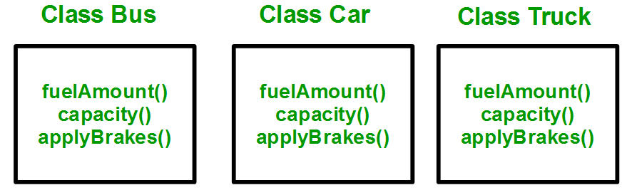
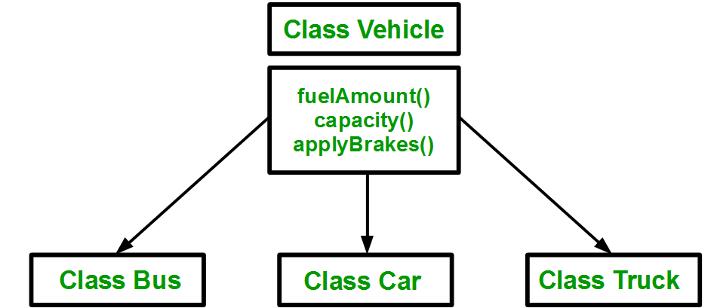

Slide 10
Advantages of OOP
Data Re-usability:- “Write once and use multiple time” we can achieve this by using class. Once write a class it can use number of time by creating the object for class.
Data Redundancy:- Inheritance is the good feature for data redundancy, if you need a same functionality in multiple class you can write a common class for the same functionality and inherit that class to sub class.

Slide 11
Advantages of OOP
Easy Maintenance:- It is easy to maintain and modify existing code as new objects can be created with small differences to existing ones.
Data hiding:- Implementation details are hidden from other modules and other modules has a clearly defined interface.
Security:- Using data hiding and abstraction we are providing necessary data only it mean we are maintaining security.

Slide 12
Approach to OO Design
Start with the simple object which can be abstracted into individual classes.
Identify all the classes in the requirement specification.
Identify the commonalities between all or small groups of classes. Do not force fit generalization where it doesn’t make sense.
Keep all the data members private or protected

Slide 13
Approach to OO Design
Identify all the member variables and methods the class should have
Ensure that the class is fully independent of other classes and contains all the necessary attributes and methods.
The methods in the class should be abstract.
Don't use the procedural code into a class for the methods in the class.

Slide 14
Approach to OO Design
Inherit and extend classes from the base classes when require.
Define the "Has-A" or "Uses-A" relationships among the classes

Slide 15
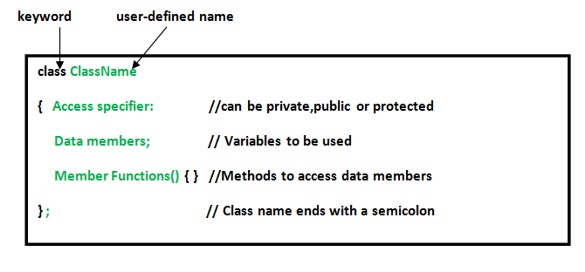
OOP Basics
Class: A class is a blueprint, template, or prototype that defines and describes the static attributes and dynamic behaviors common to all objects of the same kind.

Slide 16
OOP Basics
Objects
Objects are the basic run-time entities in an object-oriented system. Which have a behavior and state
if we consider human is object the state is name, height, weight, and the behavior is talking, walking singing etc.
Syntax: Sample objSample = new Sample()

Slide 17
OOP Basics
Instance:
Object can also be called as runtime instance of a class.
It is used to access data and function members while a program is running.
Class specification provides only a template. It does not create any memory space for the object.
To create memory space at runtime, we need to create instance of the class, which is essentially the class object.

Slide 18
OOP Basics
An instance refers to an existing object, where as an object is the type.
Object is the class variable with memory assign to all its fields but no value set between them and instance is a object of class at run time when all fields get value assigned
A car is the object, but the instance is the one you drive (versus the one I drive)

Slide 19
Instance vs Object
$car_one = new Car(); $car_two = new Car(); $car_three = new Car(); All these cars are different instances
But they are ALL "objects" of the Car class.
Example: we have a blueprint (class) represents student (object) with fields like name, age, course (class member). And we have 2 students here, Foo and Bob. So, Foo and Bob is 2 different instances of the class (Student class) that represent object (Student people).

Slide 20
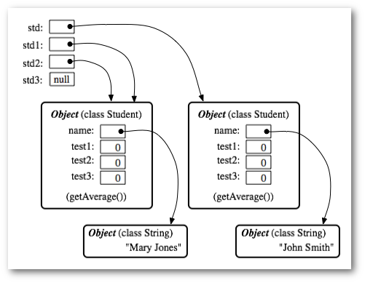
Objects are things in memory while instances are things that reference to them.

Slide 21
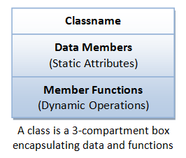
A class can be visualized as

Slide 22
A class
Classname (or identifier): identifies the class.
Member Functions (or methods, behaviors, operations): contains the dynamic operations of the class.
A class encapsulates the static attributes (data) and dynamic behaviors (operations that operate on the data) in a box.
Class Members: The data members and member functions are collectively called class members.

Slide 23
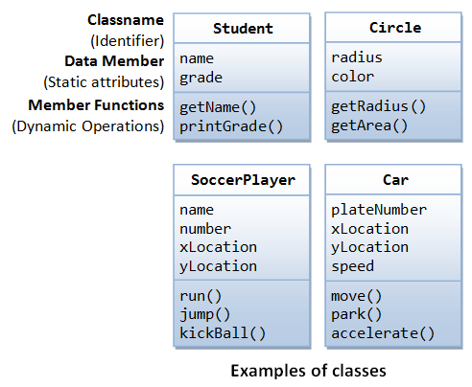
Examples of classes:

Slide 24
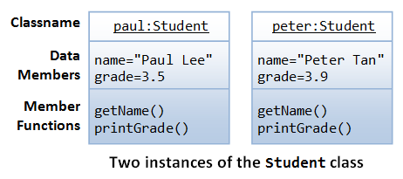
Instances of the class Student

Slide 25
Brief Summary
A class is a programmer-defined, abstract, self-contained, reusable software entity that mimics a real-world thing.
A class encapsulates the data structures (in data members) and algorithms (member functions). The values of the data members constitute its state. The member functions constitute its behaviors.
An instance is an instantiation (or realization) of a particular item of a class.

Slide 26
Class Definition
class Circle { // classname
private:
double radius; // Data members (variables)
string color;
public:
double getRadius(); // Member functions
double getArea();
}
A classname shall be a noun or a noun phrase made up of several words. All the words shall be initial-capitalized (camel-case). Use a singular noun for classname. Choose a meaningful and self-descriptive classname.

Slide 27
Creating Instances of a Class
To create an instance of a class:
Declare an instance identifier (name) of a particular class.
Invoke a constructor to construct the instance (i.e., allocate storage for the instance and initialize the variables).
Circle c1(1.2, "red"); // radius, color
Circle c2(3.4); // radius, default color
Circle c3; // default radius and color
Circle c1 = Circle(1.2, "red"); // radius, color
Circle c2 = Circle(3.4); // radius, default color
Circle c3 = Circle(); // default radius

Slide 28
Dot (.) Operator
To reference a member of a object (data member or member function), you must:
First identify the instance you are interested in, and then
Use the dot operator (.) to reference the member, in the form of instanceName.memberName.

Slide 29
Instance
// Declare and construct instances c1 and c2 of the class Circle
Circle c1(1.2, "blue");
Circle c2(3.4, "green");
// Invoke member function via dot operator
cout << c1.getArea() << endl;
cout << c2.getArea() << endl;
// Reference data members via dot operator
c1.radius = 5.5;
c2.radius = 6.6;

Slide 30
Data Members (Variables)
A data member (variable) has a name (or identifier) and a type; and holds a value of that particular type.
A data member name shall be a noun or a noun phrase made up of several words. The first word is in lowercase and the rest of the words are initial-capitalized (camel-case), e.g., roomNumber, xMax. Take note that variable name begins with an lowercase, while classname begins with an uppercase.

Slide 31
Member Functions
A member function
receives parameters from the caller,
performs the operations defined in the function body, and returns a piece of result (or void) to the caller.
A function name shall be a verb, or a verb phrase made up of several words. The first word is in lowercase and the rest of the words are initial-capitalized (camel-case). Ex-getRadius(), getParameterValues().
Take note that data member name is a noun (denoting a static attribute), while function name is a verb (denoting an action).

Slide 32
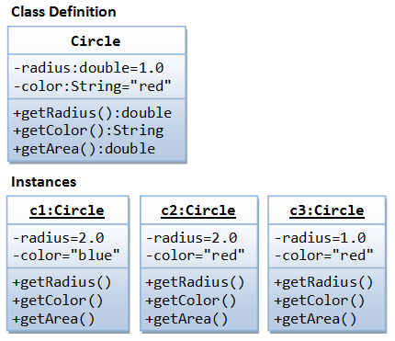
An OOP Example

Slide 33
#include <iostream> // using IO functions
#include <string> // using string
using namespace std;
class Circle {
private:
double radius; // Data member (Variable)
string color; // Data member (Variable)
public:
// Constructor with default values for data members
Circle(double r = 1.0, string c = "red") {
radius = r;
color = c;
}
double getRadius() { // Member function (Getter)
return radius;
}
string getColor() { // Member function (Getter)
return color;
}

Slide 34
double getArea() { // Member function
return radius*radius*3.1416;
}
}; // need to end the class declaration with a semi-colon
// Test driver function
int main() {
// Construct a Circle instance
Circle c1(1.2, "blue");
cout << "Radius=" << c1.getRadius() << " Area=" << c1.getArea()
<< " Color=" << c1.getColor() << endl;
// Construct another Circle instance
Circle c2(3.4); // default color
cout << "Radius=" << c2.getRadius() << " Area=" << c2.getArea()
<< " Color=" << c2.getColor() << endl;
// Construct a Circle instance using default no-arg constructor
Circle c3; // default radius and color
cout << "Radius=" << c3.getRadius() << " Area=" << c3.getArea()
<< " Color=" << c3.getColor() << endl;
return 0;
}

